Slide 1

MOVIES AND TV SHOWS
PROJECT 4 : TEAM 5
RATING

Slide 2


About
Project Goal:
Model how different attributes of Netflix TV Shows and Movies (Length, Genre, Age Certification) affect its IMDb ratings.
Target variable: IMDb Score
Features: Type, Release Year, Age Certification, Runtime, Genre, Production Countries, # of Seasons

Slide 3

Research questions
•Does a longer runtime lead to lower IMDB scores?
•What are the most popular Netflix movies and TV shows genres?
•What are the top rated Netflix movies
•What are the top rated Netflix TV shows?
•What is the average IMDB score of Netflix movies and TV shows?

Slide 4
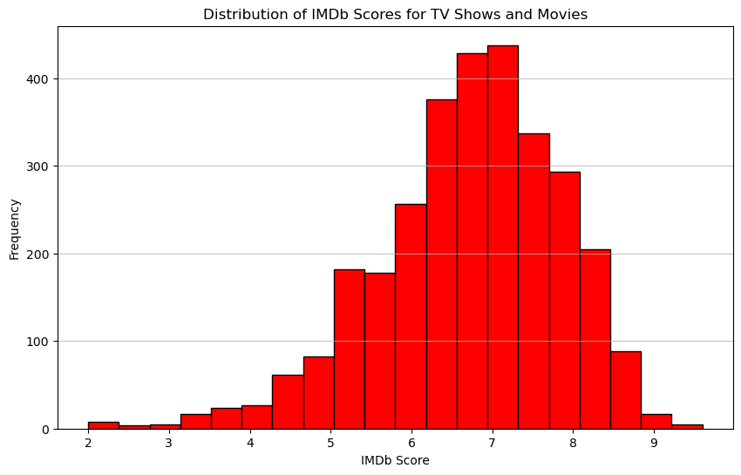
IMDb Score of Netflix TV Shows and Movies
Average IMDb scores for both TV shows : 7.2
Lowest score : 2.5
Highest score 9.5

Slide 5
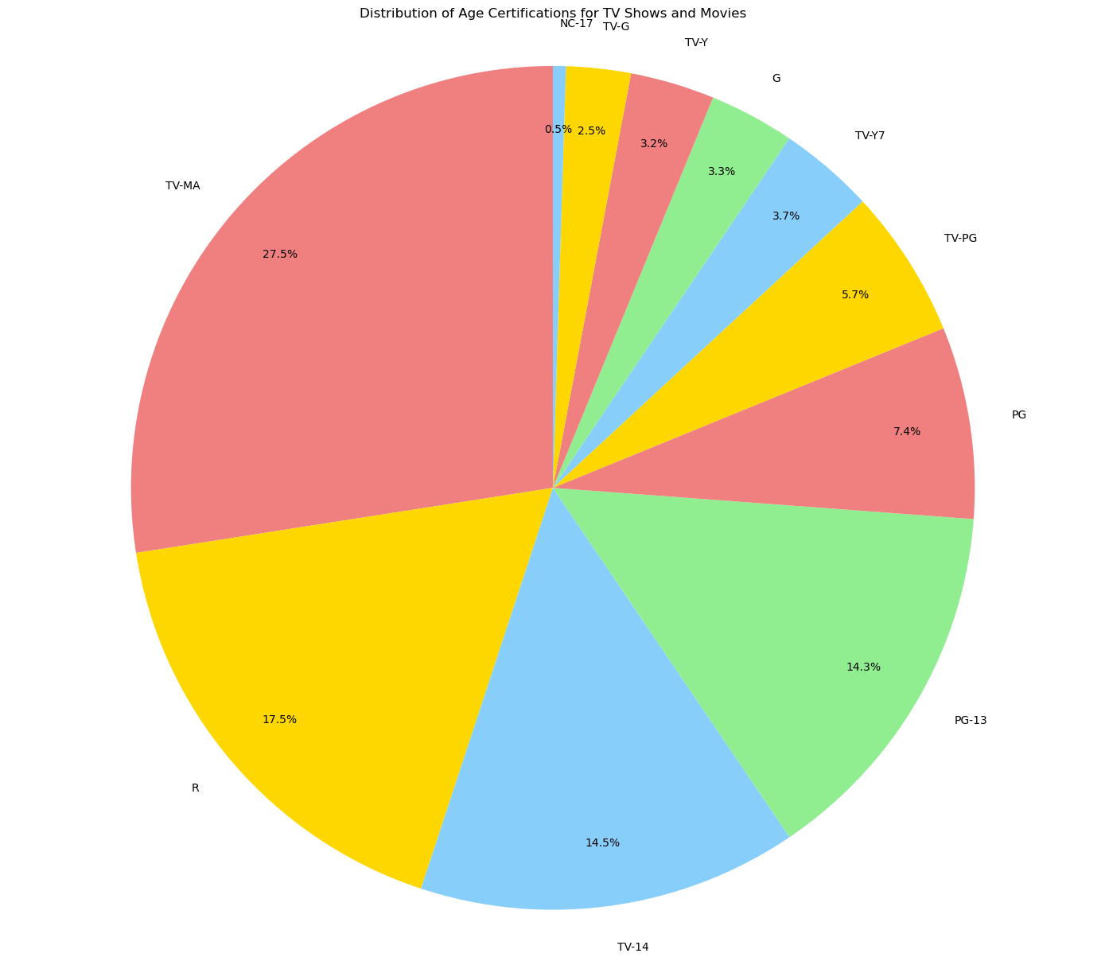
Distribution of age certifications for
TV Shows and Movies
Most common age rating
TV-MA : 27.5%
R : 17.5%
TV-14 : 14.5%
PG-13 : 14.3%,
PG : 7.4%.

Slide 6
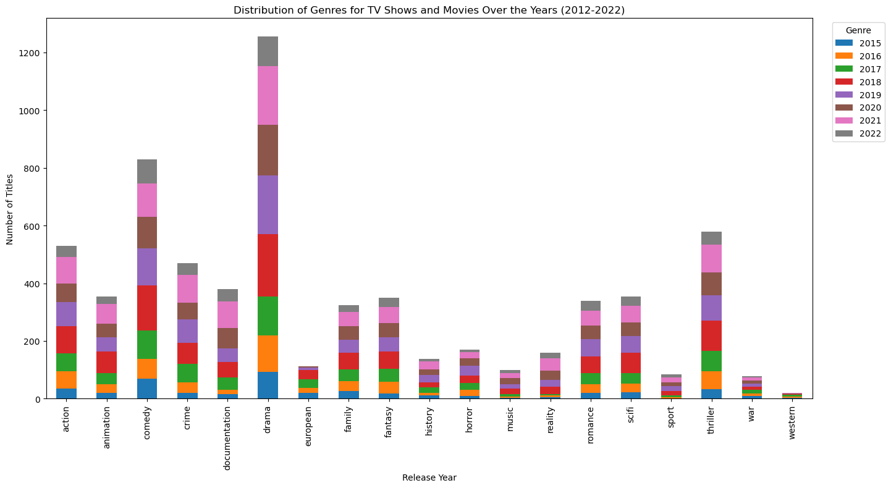
Distribution of TV Shows and Movies Genres (2012-2022)
Most popular genres
Drama
Comedy
Thriller
Action
Crime

Slide 7
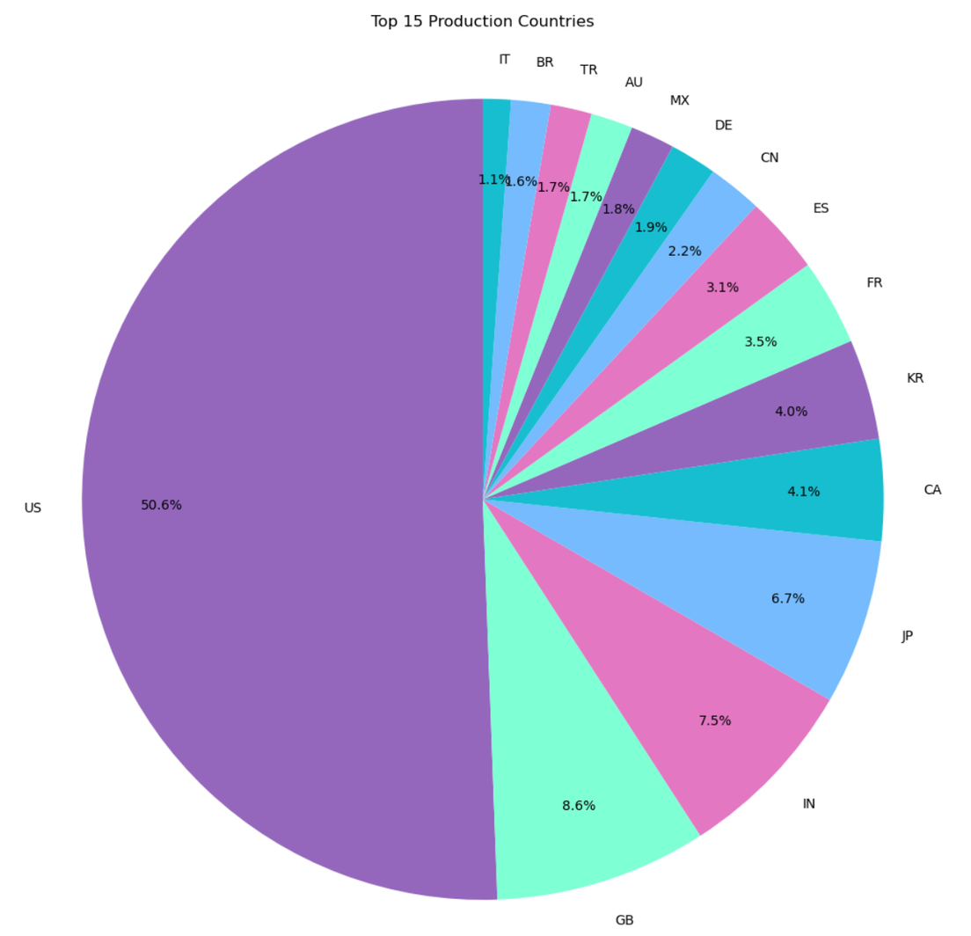
Primary Production Countries for TV shows and Movies

Slide 8
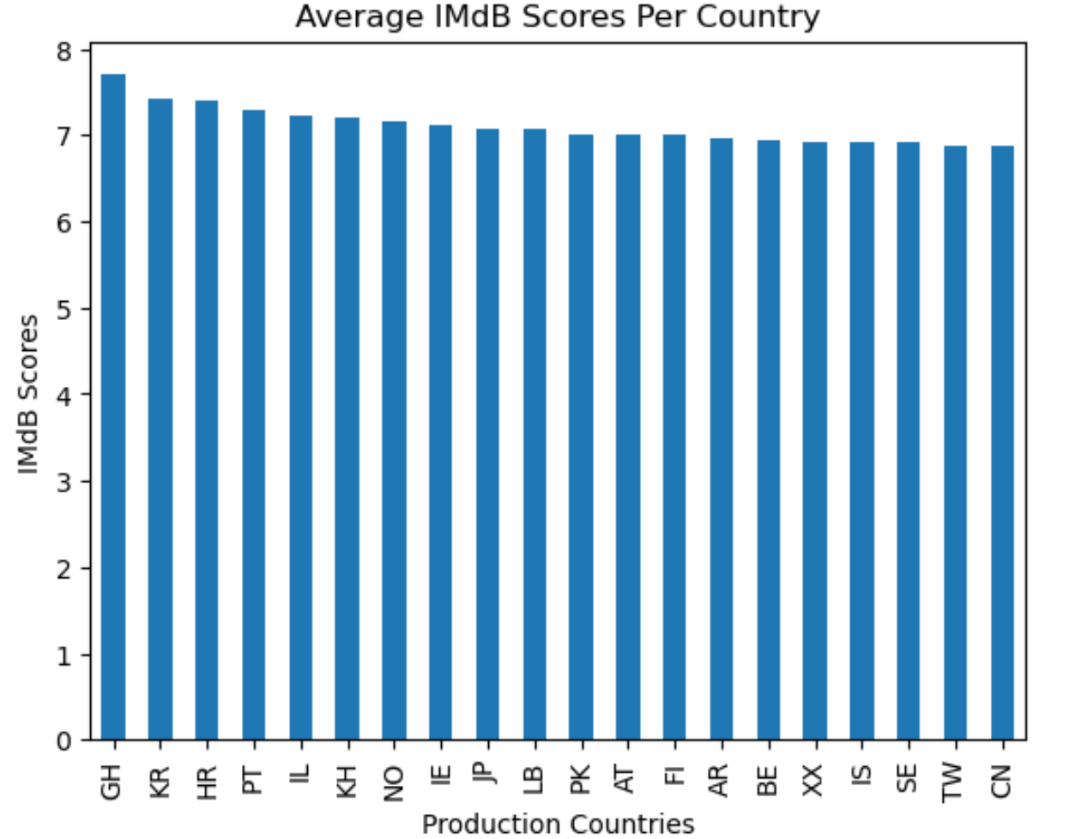
How do IMDb scores vary across Different Production Countries?

Slide 9
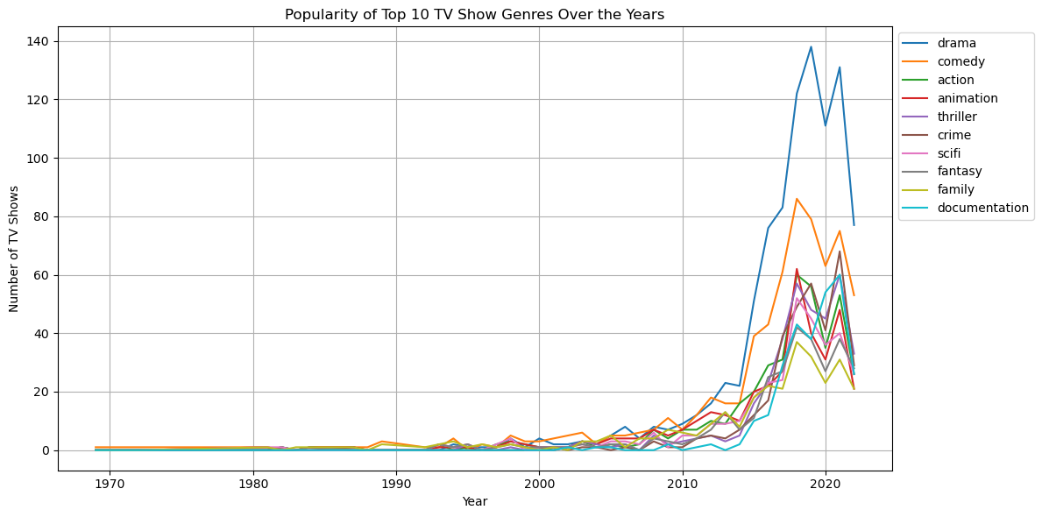
Evolution of TV Show Genre Popularity

Slide 10
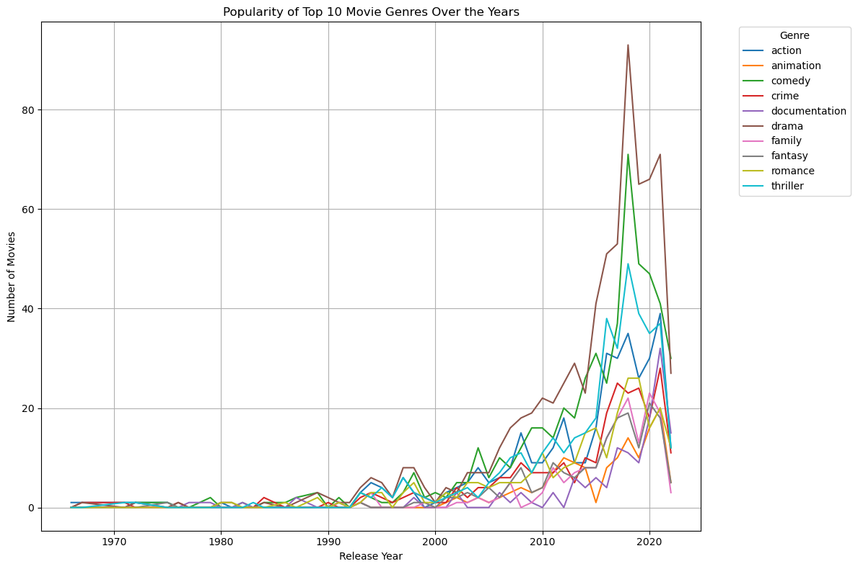
Evolution of Movie Genre Popularity

Slide 11
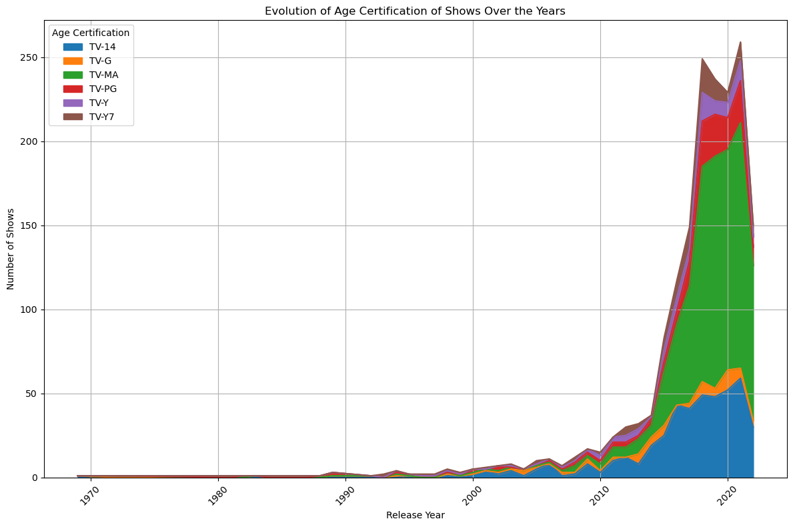
Evolution of TV Show Age Certification

Slide 12
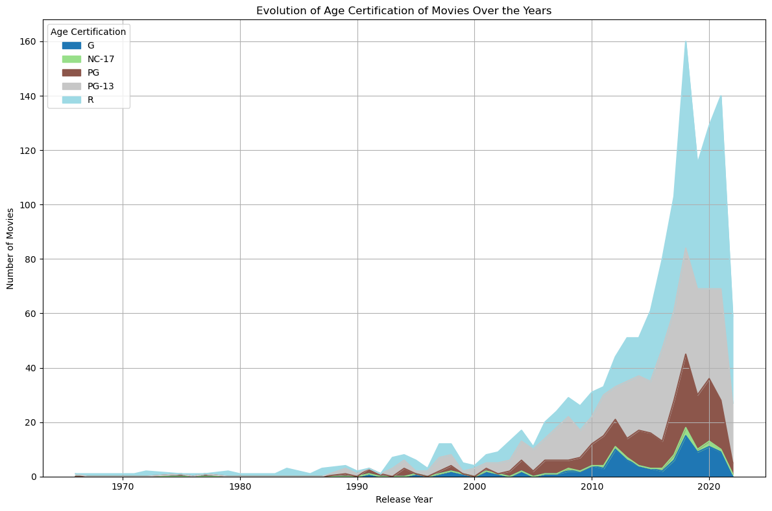
Evolution of Movie Age Certification

Slide 13
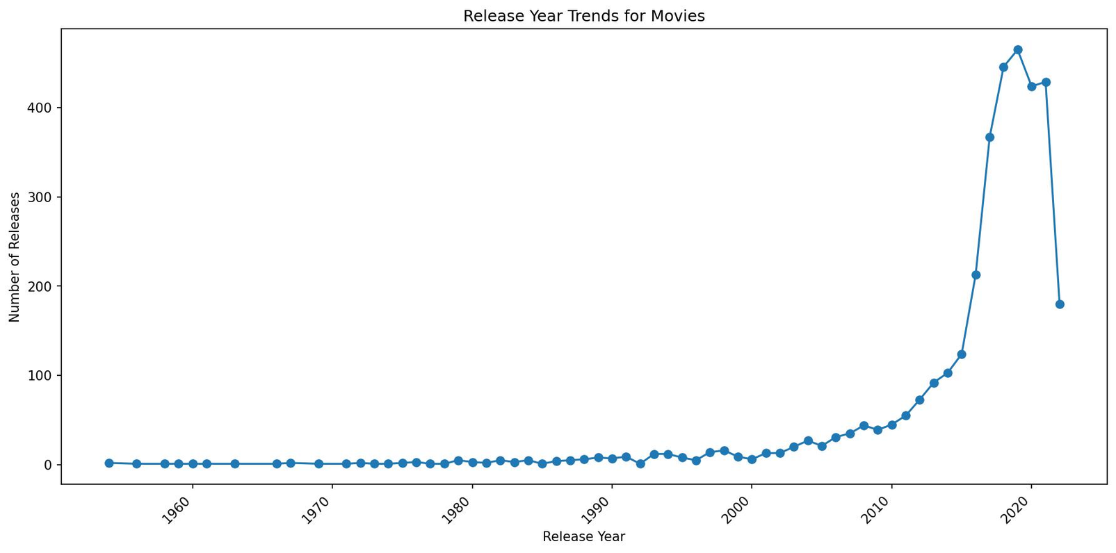
How has the number of TV shows and movies released each year changed over time?
Result: This visualization reveals trends in the production of TV shows and movies over the years.
Based on the line charts depicting release year trend, from the movie data we can see an uptrend depicting an increase in the number of movies released over the years with the greatest release number in 2019 after which we experience a downward trend

Slide 14
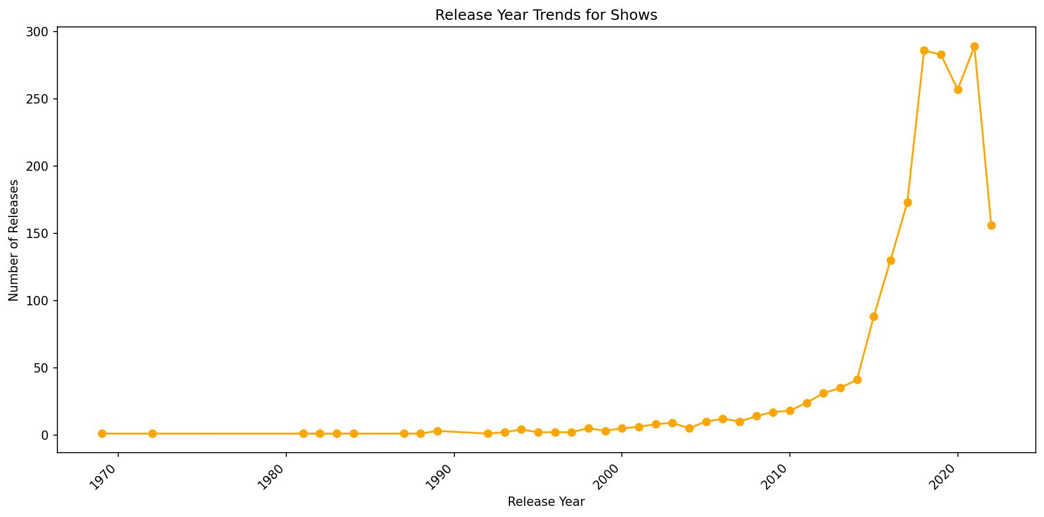
How has the number of TV shows and movies released each year changed over time?
The TV shows data follows a similar trend with the greatest release year in 2021 after which a decline is experienced.

Slide 15
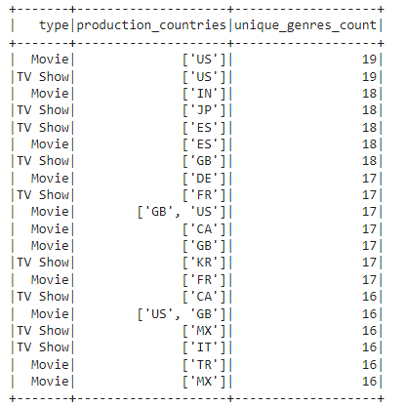
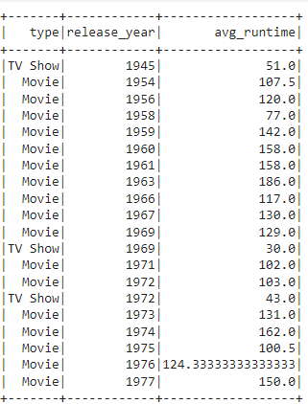
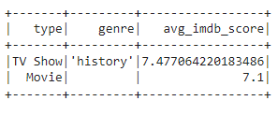
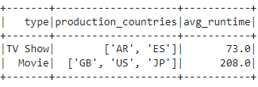
Analysis Questions
Which production countries have the most diverse genres?
What are the trends in average runtime for TV shows and movies over the years.
What genres have the highest IMDB score for movies and TV shows.
Which production countries have the highest average runtime for TV shows and movies.

Slide 16
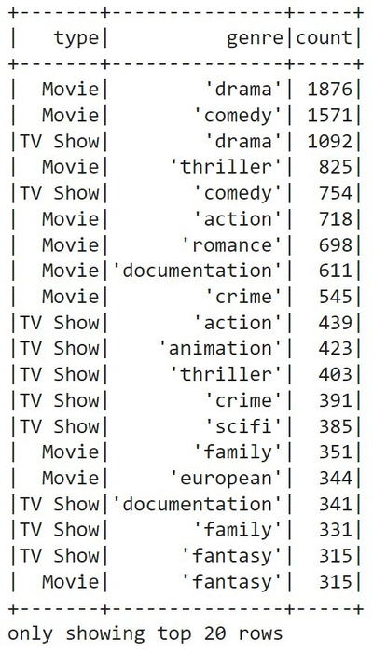
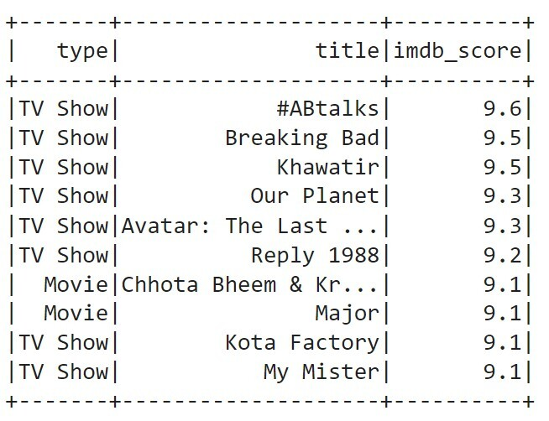
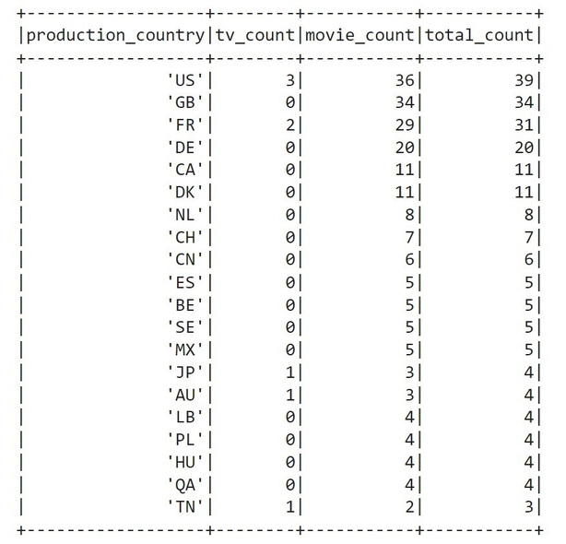
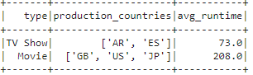
Analysis Questions
What are the top-rated TV shows and movies based on IMDb scores?
Which genres are most common among TV shows and movies?
What is the average runtime of TV shows and movies?
Which countries produce the most TV shows and movies?

Slide 17


Linear Regression
•We used a regression model to predict the IMDb score of a TV show or movie based on features such as release year, runtime, genres, and production countries.
•Release year: Coefficient of -0.0277
•Runtime: A negative coefficient (-0.0053)
•Mean Absolute Error (MAE): 0.8235
•Mean Squared Error (MSE): 1.1244
•R-squared (R²): 0.1555
•Predictions: The model's predictions range from 6.4267 to 6.1499
Conclusion
Although, the linear regression model provides valuable insights into the factors influencing IMDb scores, its performance, as indicated by MAE, MSE, and R², suggests that further refinement may be needed to improve prediction accuracy.

Slide 18
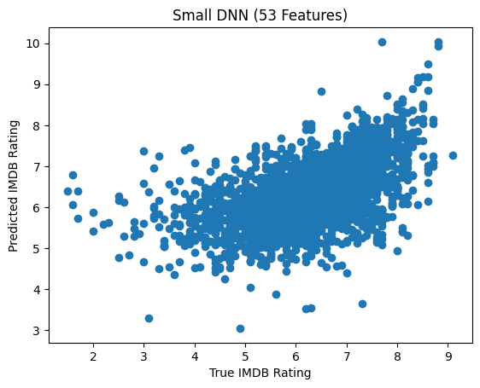

Small Movie Model
Small TF.Keras Sequential Model for initial testing
Features: Release Decade, Age Certification, Runtime, Genre, Country, and IMDB Votes
2 Hidden Dense layers
0.7 Mean Absolute Error
Small
Model training

Slide 19
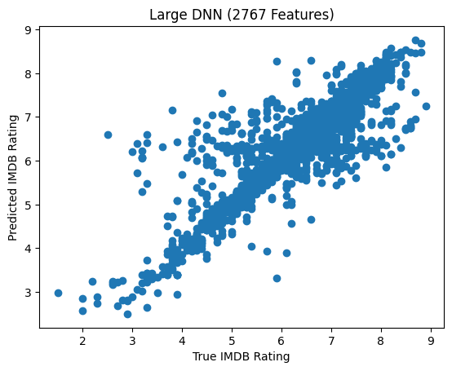
Movie model:
Tested in pandas, loaded dataframe into memory
Split dataset between show and movie to seperate differences in medium
Selected relevant features, (release year, age certification, runtime, genre, country, case, director, imdb votes)
Selected target variable (imdb score)
Replaced low entry features with generic 'other' label. to prevent overfitting whithout removing trainable feature
pd.getdummies on categorical features to one-hot-encode
5 dense layers w/ 30 units to an ouput layer with a linear activation (regression problem)
Compiled with loss function (mean absolute error)
Matplotlib to graph prediction
Large Model training

Slide 20
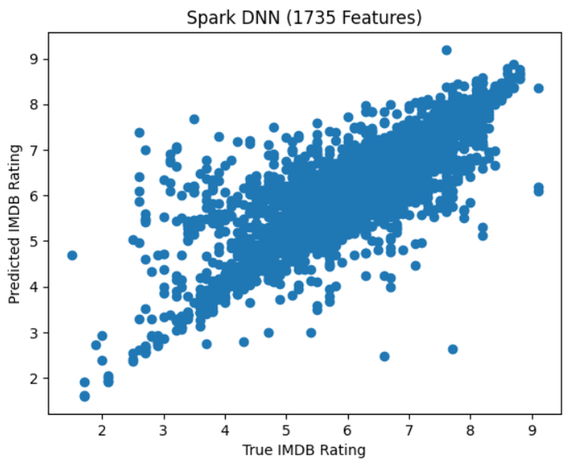
Movie model:
Preprocessed in Spark.ML to save on Memory
Used Viz to select features
StringIndexer, VectorIndexer, OneHotEncoder
Mapped Sparse Tensor to Array
Save to Parquet, load Dense Array into Pandas
5 dense layers w/ 64 units to an output layer with a linear activation
L1 Regularization, Reduce small features to 0
0.24 Mean Absolute Error
Spark Model training

Slide 21
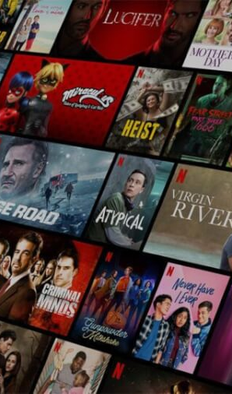
Bibliography
HTTPS://THEDAILYGUARDIAN.COM/IS-NETFLIX-COMING-BACK-TO-THE-WEEKLY-RELEASE-MODEL-OF-SHOWS/
HTTPS://ECONOMICTIMES.INDIATIMES.COM/NEWS/INTERNATIONAL/US/UPCOMING-NETFLIX-ORIGINALS-2023-CHECK-LIST-OF-ALL-THE-RENEWED-SEASONS-COMING-TO-STREAMING-GIANT/ARTICLESHOW/102358821.CMS?FROM=MDR
HTTPS://WWW.IMDB.COM/TITLE/TT5180504/
HTTPS://EDITORIAL.ROTTENTOMATOES.COM/GUIDE/BEST-NETFLIX-SHOWS-AND-MOVIES-TO-BINGE-WATCH-NOW/
https://www.whats-on-netflix.com/news/netflix-originals-now-make-up-40-of-netflix-us-library/

